Slide 1
Group Discussion #1: Forklifting an Existing Application
Notes:
The goal of this discussion is to summarize what has been covered and apply those concepts to the architecture for GoGreen.
You should approach this activity from an architectural perspective. Participants should engage in questioning the architecture changes and not just on changing the services being used.
Some suggestions for this activity that will encourage the discussion:
Appoint one member of the team as the Chief Architect and tell them to question the suggestions being made to determine WHY the change is being made.
Slide 7 has some example questions with the last 4 question categories matching the pillars of the Well-Architected Framework.
Allow teams 20 minutes to have their discussions and whiteboard a solution.
Have the Chief Architect explain their diagrams and question their decisions to ensure that they are able to justify their solution.
An example solution is provided in slides 9 – 14 to give the Instructor the opportunity to walk through the questions/answers that would go into the architecture.

Slide 2
GoGreen Background
GoGreen provides a hosted Customer Relationship Management (CRM) tool to it’s end users. Customers access the web application to:
View and log customer contact information – maintaining a record of all customer information viewable on all platforms.
Upload and access customer contract documents from anywhere – capable through browser and mobile apps.
Track status of customer forms as they proceed through the sales process – view the workflow and provide feedback on next steps or delivery expectations.
Notes:
GoGreen provides a hosted Customer Relationship Management (CRM) tool to it’s end users. Customers access the web application to:
View and log customer contact information. They maintain a record of all customer information viewable on all platforms.
Upload and access customer contract documents from anywhere. Contract documents are capable of being viewed capable through browser and mobile apps.
Track status of customer forms as they proceed through the sales process. The CRM offers the ability to view the workflow and provide feedback on next steps or delivery expectations.

Slide 3
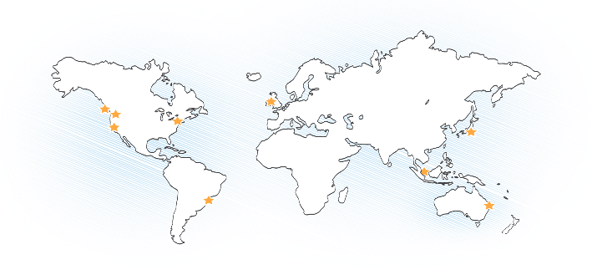
GoGreen Today
As the business grows, GoGreen is getting more and more traffic. Since the contracts with the primary data center location is expiring next year, GoGreen decided to migrate some or all of the components to the AWS cloud.
Notes:
As the business grows, GoGreen is getting more and more traffic. Since the contracts with the primary data center location is expiring next year, GoGreen decided to migrate some or all of the components to the AWS cloud.

Slide 4









GoGreen On-Premises Data Center
Datacenter
NetScaler
Active Directory
Users
Web
Server
Web
Server
DNS Server
Three-tier architecture
App Server
App Server
File System Disks
Oracle DB
(Master)
Oracle DB
(Slave)
Back-ups on tapes
Notes:
This diagram illustrates the infrastructure of the current GoGreen on-premises data center. Users connect to the GoGreen application using their user ID and password. Active Directory authenticates GoGreen employees who need to access the system (e.g., engineers and customer support personnel).

Slide 5
GoGreen Migration Requirements
Deployment
US West Coast and Southeast Asia
Web applications
Increase availability
Increase durability of data
Implement methods to lower recovery time
Increase security of mobile connections
Notes:
As part of the migration to AWS, GoGreen will require deployment in US West Coast and Southeast regions. Goals for the web applications include increased availability, increased durability of data, methods that lower recover time, and increased security of mobile connections.

Slide 6
AWS services and features to keep in mind
Global infrastructure of AWS
Regions, edge locations, and Availability Zones
Amazon Virtual Private Cloud (VPC)
VPC, public and private subnets
Security groups
Amazon EC2
AMI
Elastic Network Interface, Elastic IP
Amazon Data stores
Instance Store, EBS, S3, Glacier
RDS, DynamoDB
Notes:
What will help to move this architecture to AWS?
Consider the following details as you plan for the migration:
The global infrastructure of AWS including regions, edge locations, and availability zones.
The Amazon Virtual Private Cloud (Amazon VPC) which includes VPC and public and private subnets.
Amazon EC2 including AMIs for templated instance creation and Elastic IP, the Elastic Network Interface.
Different types of Amazon data stores including EBS, S3 Glacier and database services like RDS and DynamoDB.

Slide 7


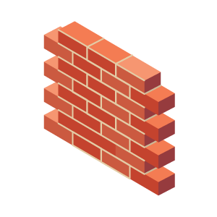

Group Assignment: Planning for Migration
Work in groups to whiteboard the changes to the architecture. Consider the following:
Administrative: How many VPCs? Subnets? What size subnets and VPC CIDR? How about Groups and Roles?
Security: How can we increase security of data at rest and data in transit?
Performance Efficiency: What Amazon EC2 instance types to use?
Reliability: Are any topology changes necessary?
Cost: How can we scale this service effectively and in a cost optimized fashion?
NetScaler
Active Directory
Web
Server
Web
Server
App Server
App Server
File System Disks
Oracle DB
(Master)
Oracle DB
(Slave)
Back-ups on tapes
Notes:
Work in groups to whiteboard architecture changes. Consider the following:
For Administrative purposes, how many VPCs and / or Subnets do we need? What size subnets and VPC CIDR? Should we use? Should we use Groups and Roles? When you discuss VPC, be sure to talk about subnets. If you need to, select the link to view online documentation. http://aws.amazon.com/documentation/
In terms of Security, how can we increase security of data at rest and data in transit?
To increase Performance Efficiency, what Amazon EC2 instance types to should be used?
Are any topology changes necessary to improve Reliability?
How can we scale this service effectively and in a Cost optimized fashion?

Slide 8
Design considerations
Notes:
Have your Chief Architect explain your diagrams. Other teams should question their decisions to ensure that they are able to justify their solution.

Slide 9

Access Control - IAM
Account
Group: Admins
Group: Developers
Group: Testers
Role: Applications
Joe
Josh
Jenn
Monitor
Nate
Bob
Brad
Reporting
Scott
Susan
Batch
Dave
Sam
Notes:
In regard to the Active Directory or LDAP that you may have in the corporate data center, did you discuss access control using IAM?

Slide 10
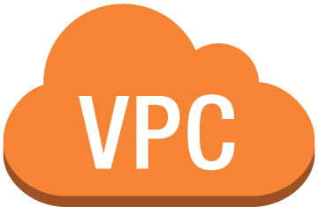
How Many VPCs?
Multiple VPCs?
DEV, QA, and PROD?
How big of a CIDR block per VPC?
Notes:
Some of the VPC questions you should be asking:
Should the solution have a single or multiple VPCs?
How many availability zones do we need to achieve high availability?
Should subnets be used? If subnets are used, should they be public or private?
How do you plan to accommodate development, quality assurance and production environment?
How big should the CIDR block be?
Single region would need at least one VPC. Best Practice would be to have one VPC per environment (DEV/QA/PROD) for a total of three VPCs per region. By architecting our solution in three VPCs we have the ability to have an active Dev, Test, and Prod environment at the same time. Should these VPCs have the same IPs?
At this point we are unable to determine the size of the CIDR blocks that are necessary because we must know our subnet pattern to know how many IPs we will be using.

Slide 11







Subnets
/20
Internet Gateway
NAT
NAT
Web Tier
Web Tier
Public Subnet
/24
/24
Public Subnet
App Tier
App Tier
DB Tier
DB Tier
Private Subnet
/23
/23
Private Subnet
us-west-2 region
Availability Zone 1
Availability Zone 2
Notes:
Per VPC we will need to achieve high availability which means we will need to utilize a minimum of two availability zones. Within our Availability Zones we will need to define our subnets. Each subnet is AZ scoped meaning we will need a subnet in each availability zone. Best practices dictates that we only expose absolutely necessary equipment to the outside world so we know that we want at least one Private Subnet to ensure that we can launch servers in a protected manner. Because we are designing an application that we want available over the Internet we will need to have a Public Subnet in each AZ as well. For a properly designed HA solutions we will need 2 subnets in each AZ (4 total subnets for a security optimized HA application).
The size of each Subnet will be dependent on how many hosts we expect to have in each subnet plus additional room for growth.
Lets assume that we intend to initially deploy with only 1 servers in each tier (1 Web Server, 1 App Server, 1 Database Server). We first need to decide which subnet each of these tiers will be in. Our database servers do not need to be reached from the outside world so we can place them in the Private subnet. Our App servers act as a middle tier between our Database and Web servers and do not need to be accessed directly either so we can place them in the private subnet.
In your discussion did you determine whether the Web server should be in a Public or Private subnet? It is true that we need to be able to reach the Web servers from the web, but we don’t need to access them directly. If we put them in the Public subnet we expose the servers to the outside world which leaves them vulnerable. Instead, we could put the Web servers in the Private Subnet and have an Elastic Load Balancer be our public facing endpoint. The ELB will allow connections to come in from the Internet and distribute the requests across each of the web servers in the private subnet.
We will still need to reach out to the internet to perform updates on our private boxes so we will plan to have a NAT instance in each AZ as well which will provide NAT services to all servers in the private subnet. We would also want to plan for adding additional resources in each tier for higher workloads.
When doing our IP count we need to remember that each subnet will automatically reserve the first four (4) IPs and the last IP of each block. This means that our Public IP count is a minimum of 7 and our private IP count is a minimum of 3 plus room for significant growth. The public subnets should be a minimum of a /28 (16 IPs – 5 reserved = room for 11 hosts in the subnet). The private subnets should be a minimum of a /28 as well but best practice says that our private subnets should be double the size of our public subnet which means we should provision a /27 (32 IPs – 5 reserved = 27 hosts in the subnet.
Now that we know our subnet sizes we can add them together – 2x /27s, 2x /28s is equal to 3x /27s which means our VPC should be a /25.
This is a typical structure, but not the only way. What did your group come up with? Did you put everything in the same subnet? Did you have granular subnets?
The suggested subnetting in this slide has:
Multi-AZ for high availability.
NAT instance—Internet gateway for connectivity.
Web-tier, app-tier and database-tier are in private subnets because end users do not need to connect directly to the servers. Often, companies have a specific IP range for those servers. You can set the CIDR block for each subnet.

Slide 12
Subnets
/20
Internet Gateway
NAT
NAT
Public Subnet
/24
/24
Public Subnet
Web Tier
Web Tier
App Tier
App Tier
DB Tier
DB Tier
Private Subnet
/23
/23
Private Subnet
us-west-2 region
Availability Zone 1
Availability Zone 2
Notes:
Take a moment to review this architecture.

Slide 13
What Other Design Considerations?
Load Balancer
What ports should we configure on our Elastic Load Balancer?
Database
Should we use RDS or EC2 Instances?
How will our Database scale?
Web and application servers
Where will our content be stored?
How will we secure our resources?
Notes:
Some additional design questions that should be asked are:
For load balancing, what ports should we configure on our Elastic Load Balancer?
For the database, should we use RDS or EC2 instances? How will our database scale?
For the web and application servers, where will our content be stored, and how will we secure our resources?

Slide 14
Share What Your Group Discussed
Notes:
Have your Chief Architect explain your diagrams.
Other teams should review the diagrams to ensure that the proposed architecture meets the requirements specified by the customer. You should also question their decisions to ensure they are able to justify their solution.

Slide 15
Thanks for participating!
© 2018 Amazon Web Services, Inc. or its affiliates. All rights reserved. This work may not be reproduced or redistributed, in whole or in part, without prior written permission from Amazon Web Services, Inc. Commercial copying, lending, or selling is prohibited. Corrections or feedback on the course, please email us at: aws-course-feedback@amazon.com. For all other questions, contact us at: https://aws.amazon.com/contact-us/aws-training/. All trademarks are the property of their owners.
Notes:
Thanks for participating!

